Slide 1


Slide 2

ERD Concepts

Slide 3

Standardization and better Data accessibility and response (SQL)
  Sharing data.
    Different users get different views of the data
Enforcing Integrity Constraints
Restricting Unauthorized Access.
Providing Backup and Recovery.
    Disaster recovery is easier
Minimal Data Redundancy
    Leads to increased data integrity/consistency
Program-Data Independence

Slide 4

It needs expertise to use
DBMS itself is expensive
The DBMS may be incompatible with any
other available DBMS
ERD Concepts

Slide 5

Analysis -> System Analyst
  Requirement Document
Database Design -> Database Designer
  Entity Relationship Diagram [ERD]
Database Mapping -> Database Designer
  Database Schema
Database Implementation -> Database Developer
  Using DBMS (SQL Server) To Create The Database
Application -> Application Programmer
  Web – Desktop – Mobile
Client -> End User
  Use Database Indirectly Through The Application

Slide 6

Database Administrator (DBA)
System Analysts
Database Designer
Database Developer
Application programmers
BI & BigData Specialist (Data Scientist)
End users
ERD Concepts

Slide 7


Slide 8

Basic constructs of the E-R model:
  Entities - person, place, object, event, concept (often corresponds to a real time object that is distinguishable from any other object)
  Attributes - property or characteristic of an entity type (often corresponds to a field in a table)
  Relationships – link between entities (corresponds to primary key-foreign key equivalencies in related tables)
ERD Concepts

Slide 9

access-date
cust-name
number
cust-id
has
customer
account
cust-street
cust-city
balance
Rectangles: entity sets
Diamonds: relationship sets
Ellipses: attributes
ERD Concepts

Slide 10

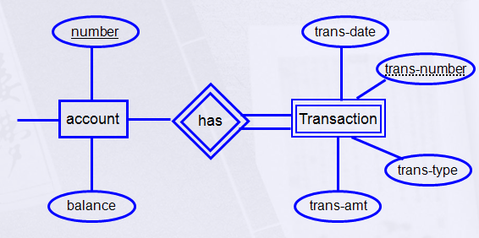
A Strong Entity- An Entity set that has a primary key.
A Weak Entity- An entity set that do not have sufficient attributes to form a primary key.
Partial key: A set of attributes that can be associated with P.K of an owner entity set to distinguish a weak entity.
ERD Concepts
Notes:
Weak entity
An entity that does not have a key attribute
A weak entity must participate in an identifying relationship type with an owner or identifying entity type
Entities are identified by the combination of:
A partial key of the weak entity type
The particular entity they are related to in the identifying entity type
Example:
Suppose that a DEPENDENT entity is identified by the dependent’s first name and birth date, and the specific EMPLOYEE that the dependent is related to. DEPENDENT is a weak entity type with EMPLOYEE as its identifying entity type via the identifying relationship type DEPENDENT_OF

Slide 11

Composite Attribute
Multi-valued Attribute
Derived Attribute
Complex Attribute
Simple Attribute
ERD Concepts

Slide 12

access-date
cust-name
number
cust-id
has
customer
account
cust-street
cust-city
balance
ERD Concepts

Slide 13

First
Last
number
Name
has
date-of-birth
customer
account
balance
month
day
year
ERD Concepts

Slide 14

age
number
date-of-birth
has
Emp
account
Salary
Deduction
Net Salary
balance
derived (dashed ellipse)
ERD Concepts

Slide 15

number
address
has
customer
account
phone no.
balance
multi-valued (double ellipse)
ERD Concepts

Slide 16

Street
City
Country
number
address
has
customer
account
balance
multi-valued + Composite
ERD Concepts

Slide 17

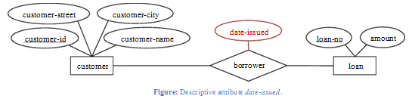
A Relationship is an association among several entities.
A relationship may also have attributes
For example, consider the entity sets customer and loan and the relationship set borrower. We could associate the attribute date-issued to that relationship to specify the date when the loan was issued.
ERD Concepts

Slide 18
Relationship has three Properties:
  Degree of Relationships
  Cardinality Constraint
  Participation Constraint

Slide 19

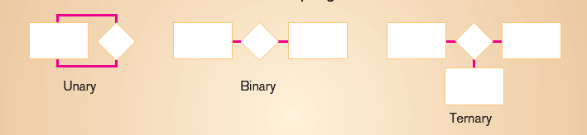
Degree: number of entity types that participate in a relationship
Three cases
  Unary: between two instances of one entity type
  Binary: between the instances of two entity types
  Ternary: among the instances of three entity types

Slide 20

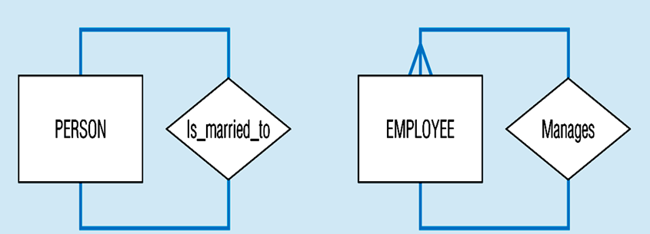
  Recursive Relationships - A relationship in which the same entity participates more than once.

Slide 21

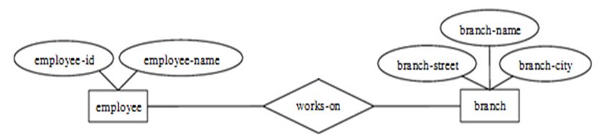
A binary relationship set is of degree 2.

Slide 22

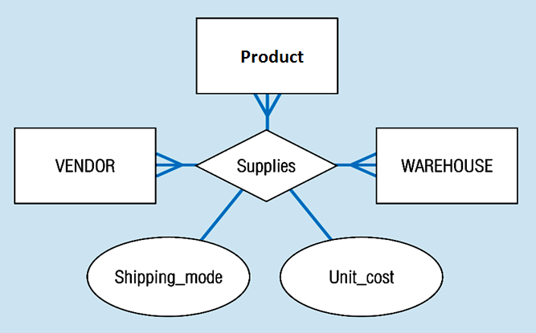
ternary relationship set is of degree 3.

Slide 23

How many instances of one entity will or must be connected to a single instance from the other entities.
  One-One Relationship
  One-Many Relationship
  Many- Many Relationship
Notes:
Relationship: Establishes a connection or correspondence or link between a pair of tables in a database, or between a pair of entities in an entity-relationship diagram (ERD).
One-to-one relationship: A single record in table A is related to only one record in table B, and vice versa.
One-to-many relationship: A single record in table A can be related to one or more records in table B, but a single record in table B can be related to only one record in table A.
Many-to-many relationship: A single record in table A can be related to one or more records in table B, and vice versa. Problems with many-to-many relationships: one of the tables will contain a large amount of redundant data, both tables will contain some duplicate data, it will be difficult to add, update, delete records because of the duplication of fields between tables.

Slide 24

One-to-One
One-to-Many
Many-to-Many
1
own
1
Employee
Car
1
has
M
Department
Employee
M
take
M
Course
Student
ERD Concepts

Slide 25

An employee MUST work for a department
An employee entity can exist only if it participates in a WORKS_FOR relationship instance
So this participation is TOTAL
Only some employees manage departments
The participation is PARTIAL

Slide 26
PARTICIPATION CONSTRAINT
Has
Employee
Car
An Employee may have a car.
A Car must be assigned to particular employee

Slide 27
PARTICIPATION CONSTRAINT
Hire
Department
Employee
- A department may hire many employees ( Zero or more)
An employee must be employed by a department
(Department membership is Optional, Employee membership is Mandatory)

Slide 28

Different Types of Keys:
  Candidate Key
  Primary Key
  Foreign Key
  Composite Key
  Partial Key
  Alternate key
  Super Key
ERD Concepts

Slide 29

Candidate key: is a set of one or more attributes whose value can uniquely identify an entity in the entity set
  Any attribute in the candidate key cannot be omitted without destroying the uniqueness property of the candidate key.
Example:
  (SSN, Name) is NOT a candidate key .
  “SSN” is a candidate key of customer.
  Candidate key could have more than one attributes.
ERD Concepts
Notes:
It is minimal super key.
,
because taking out “name” still leaves “SSN” which can uniquely identify an entity.

Slide 30

Example: Both “SSN” and “License #” are candidate keys of Driver entity set.
Primary Key: is the candidate key that is chosen by the database designer as the unique identifier of an entity.
[Unique & Not Null]
Primary key May be Composite
ERD Concepts
Notes:
In building a database in a database software, the software will only allow to use one candidate key to be the unique identifier of an entity for an entity set.

Slide 31

The key is underlined
ERD Concepts
Notes:
In building a database in a database software, the software will only allow to use one candidate key to be the unique identifier of an entity for an entity set.

Slide 32


Identifying relationship is links strong entities to weak entities and represented with double line diamond

Slide 33

ERD Concepts

Slide 34
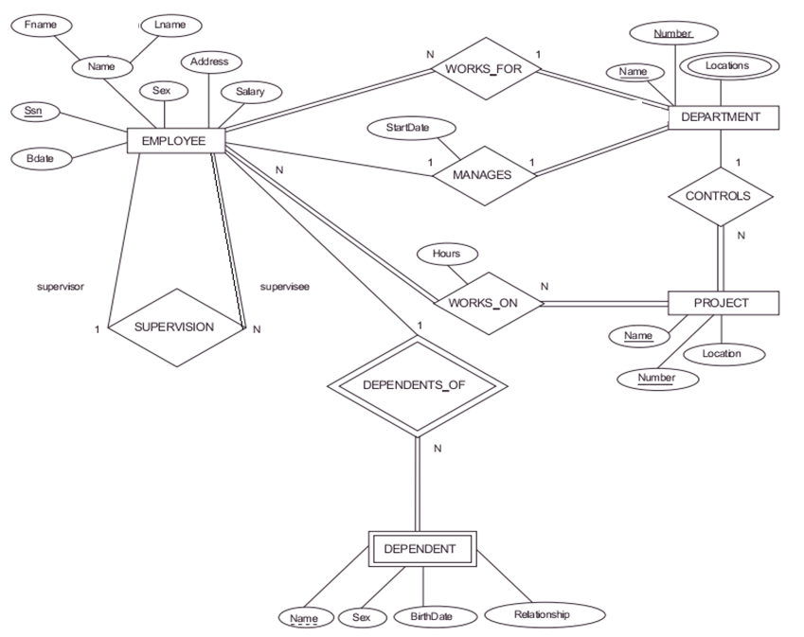

Slide 35

ERD Concepts

